Slide 1

“OIL SPILL DETECTION”
Project Presentation
MITU22BTCS0228:- Kunal Borse
MITU22BTCS0:- Rugved Shete
MITU22BTCS0260:- Dheeraj Nair
Guided by:- Prof. Vilas Khedekar
Department of Computer Science & Engineering, MITSoC, Loni Kalbhor

Slide 2
Outline
Introduction
Problem Statement
Objectives
Concepts & Methods
Literature Review
Identification of gaps & scope of work
Implementation
Reference
Q&A
Department of Computer Science & Engineering, MITSoE, Loni Kalbhor

Slide 3
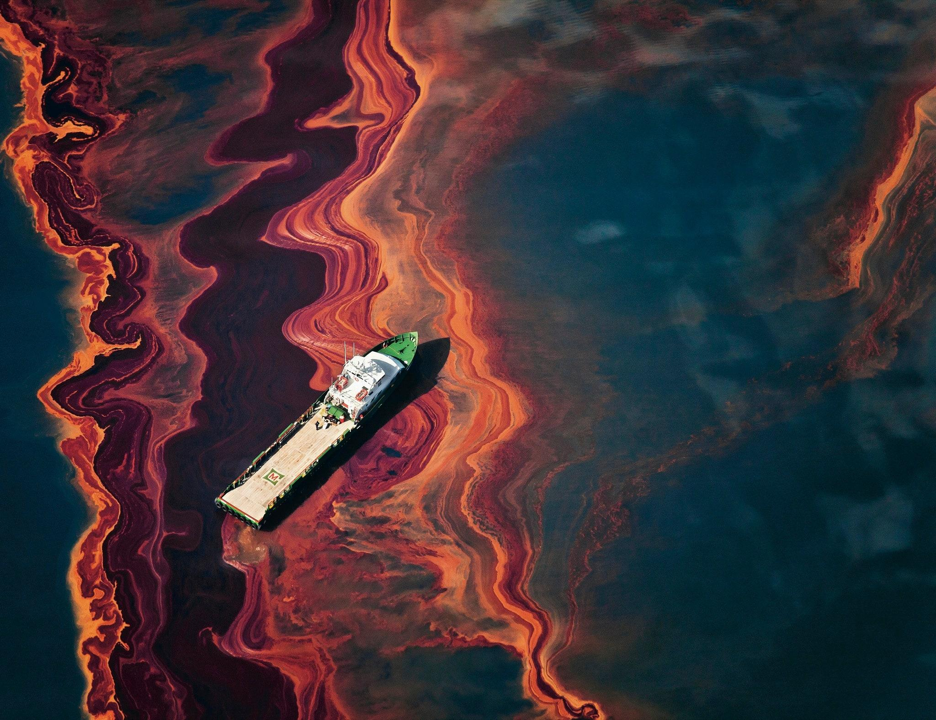
Introduction
This project focuses on creating a system that uses satellite images and machine learning to detect oil spills in the ocean. Oil spills can have serious negative effects on marine life and coastal communities, and traditional methods of spotting them are often slow and require a lot of manual effort. Our approach aims to streamline the process by automating detection, which could help environmental agencies respond more quickly and effectively to these accidents. In this project, we explain how we harness remote sensing data, develop and train our machine learning model, and test the system’s accuracy in distinguishing oil spills from other similar features on the water.
Department of Computer Science & Engineering, MITSoE, Loni Kalbhor

Slide 4
Problem Statement
Oil spills pose a significant environmental threat to marine ecosystems, affecting aquatic life and coastal economies. Early detection and timely response are crucial to mitigating their impact. This project aims to develop a machine learning model that classifies satellite images of water bodies as an oil spill or no spill.
Environmental Threat: Oil spills pose a serious threat to marine ecosystems, affecting wildlife, water quality, and coastal communities, necessitating timely detection and mitigation.
Delayed Detection: Traditional oil spill detection methods are often slow, labor-intensive, and dependent on manual observation or limited satellite passes, leading to delayed response times.
Integration with Response Systems: There is a lack of integration between detection systems and emergency response frameworks, delaying containment and cleanup operations once a spill is identified.
Objectives
The objective of this project is to develop an automated and accurate oil spill detection system using remote sensing data and machine learning techniques. It aims to enhance detection accuracy, reduce false positives, and support timely response efforts to minimize environmental impact and protect marine and coastal ecosystems.
Department of Computer Science & Engineering, MITSoE, Loni Kalbhor

Slide 5
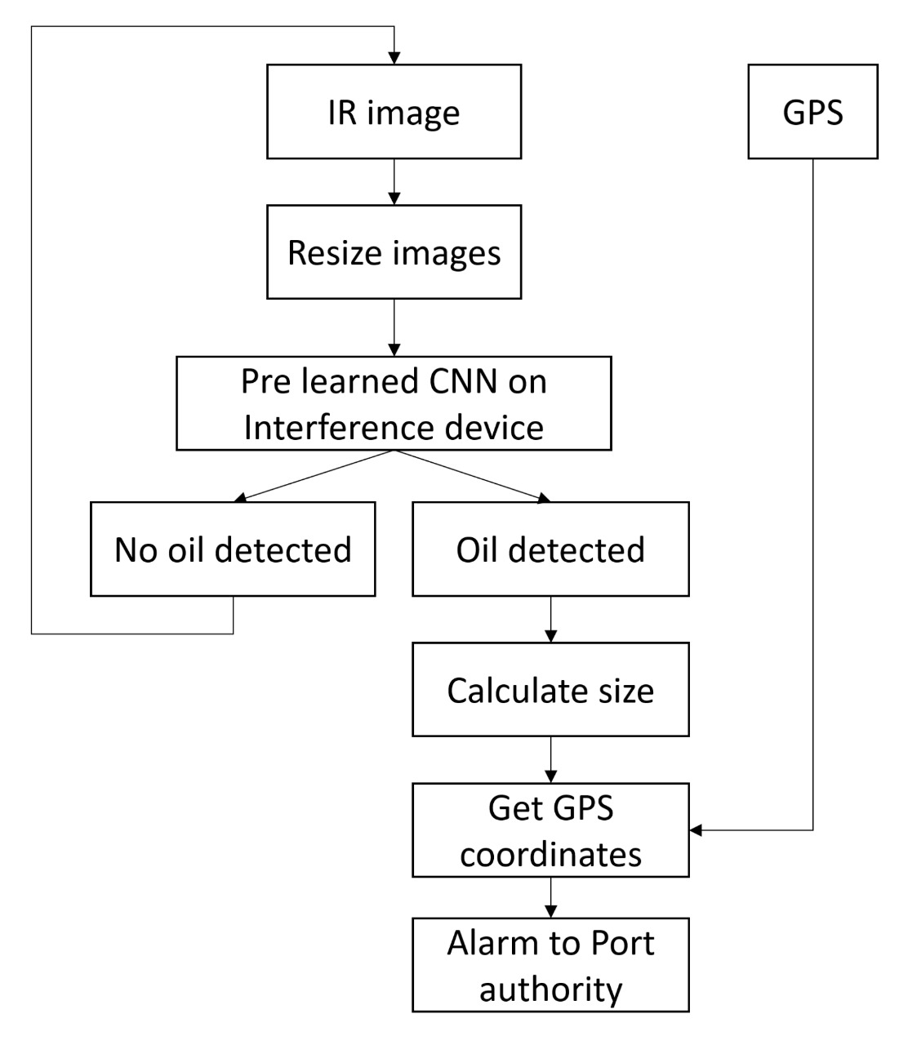
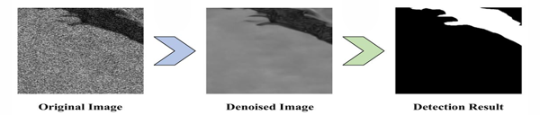
Concepts and Methods
1) Satellite Imagery: Captures high resolution images of the ocean surface to detect and monitor oil spill patterns and spread.
2) Remote Sensing: Utilizes various sensors on satellites to analyze the oil's spectral signature and differentiate it from water.
3) Data Analytics: Applies algorithms and machine learning to interpret oil spill data and satellite images, improving spill detection accuracy.
4) Aerial Surveillance (Drones and Aircraft):
Captures high-resolution images or videos to visually detect and monitor oil spills, especially in remote areas.
Department of Computer Science & Engineering, MITSoE, Loni Kalbhor

Slide 6
Modules Proposed in Project Phase I
Data collection using satellite or drone images
Design and train a machine learning/deep learning model
Evaluate model accuracy using key performance metrics
Comparative analysis of different detection algorithms
Investigate model's ability for large-scale deployment
Department of Computer Science & Engineering, MITSoE, Loni Kalbhor

Slide 7
Status of modules completed in Phase I
Completed data collection using satellite and drone images.
Designed and successfully trained the machine learning model.
Model accuracy was evaluated using key performance metrics.
Performed a comparative analysis of different detection algorithms.
Investigated the model's ability for large-scale deployment.
Department of Computer Science & Engineering, MITSoE, Loni Kalbhor

Slide 8
Modules Proposed for Project Phase II
Investigate the use of high-resolution SAR satellite images
Integrate the model with real-time marine response systems
Develop enhanced algorithms to reduce false positive detections
Explore deep learning techniques for better oil spill segmentation
Department of Computer Science & Engineering, MITSoE, Loni Kalbhor

Slide 9
Project Development Plan
Gather and preprocess satellite and drone images
Design and train a machine learning/deep learning model
Evaluate model accuracy using key performance metrics
Compare different detection algorithms to find the best fit
Investigate model's ability for large-scale deployment
Department of Computer Science & Engineering, MITSoE, Loni Kalbhor

Slide 10
Thank You
Department of Computer Science & Engineering, MITSoE, Loni Kalbhor

